Slide 1



Genesis of Hurricane Julia (2010) from an African Easterly Wave
Stefan Cecelski¹ and Dr. Da-Lin Zhang
Department of Atmospheric and Oceanic Science, University of Maryland
1: Research is funded by NASA’s Earth and Space Science Fellowship (NESSF)

Slide 2
Motivation
The genesis of Julia (2010) was not well anticipated;
Introduced into the Tropical Weather Outlook (TWO) with a medium (30%) chance of formation only 18 h prior to transition to TD and a 70% chance of genesis 6 h prior to TCG (Tropcical Cyclone Report, Beven and Landsea);
Explore the meso-β development (vorticity generation);
What role does convection play for the development within the AEW?

Slide 3
Objectives
Examine the genesis of Julia from the merging of several meso-β-scale vortices within the AEW;
Study how deep convection, invigorated through a high θ_{e} and storm-relative helicity (SRH) environment, contributes to the development of the meso-β-scale vortices;
Show that the vorticity maxima (and related convection) lies on the critical level (latitude) Dunkerton, et al. 2009, the latitude where the wind speed equals the phase speed of the AEW)

Slide 4
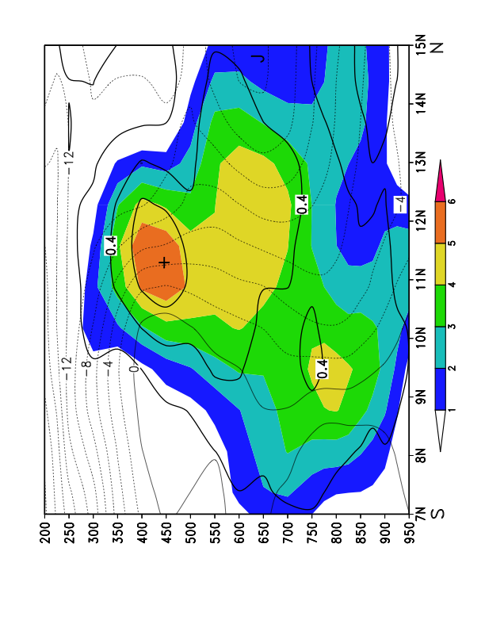
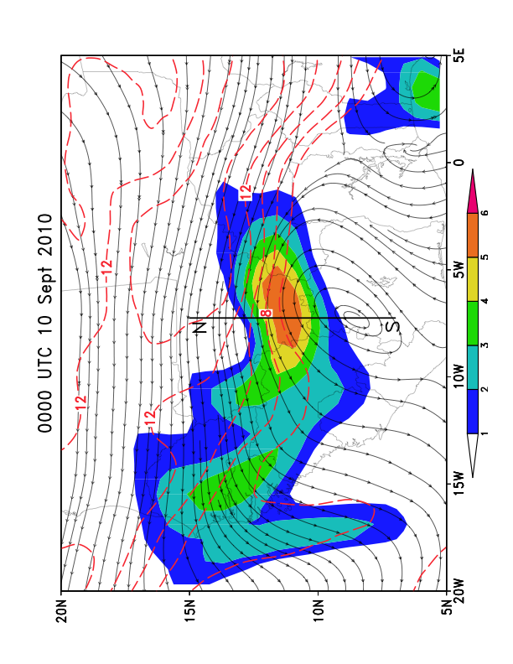
AEW and AEJ
Relative vorticity (shaded), zonal wind (dashed/solid thin line, m/s) and potential vorticity (thick solid line, contoured every .2 PVU).
450-hPa Relative Vorticity (shaded, 10⁻⁵ s⁻¹), 650-hPa Streamlines (resting frame) and Isotachs (red-dashed contours, m/s).
J = Location of AEJ
+ = Positive Upper-level PV
Box = Location where meridional PV gradient goes negative
Notes:
The wave that became Julia was quite strong and had a closed circulation even in the the resting frame. The AEJ sat to the north of the disturbance, with substantial cyclonic shear vorticity being created on its southern side. The time shown is the initialization time of the WRF simulation.

Slide 5
WRF Simulation Set-up
Initialized 0000 UTC 10 Sept 2010
78-hour integration
12/4/1.33 km triple-nested simulation
Used ERA-Interim for atmospheric IC and BCs and NOAA Optimal Interpolation SST data to initialize SSTs
Used new Kain-Fritsch (KF) convective parameterization for 12 and 4 km domains

Slide 6
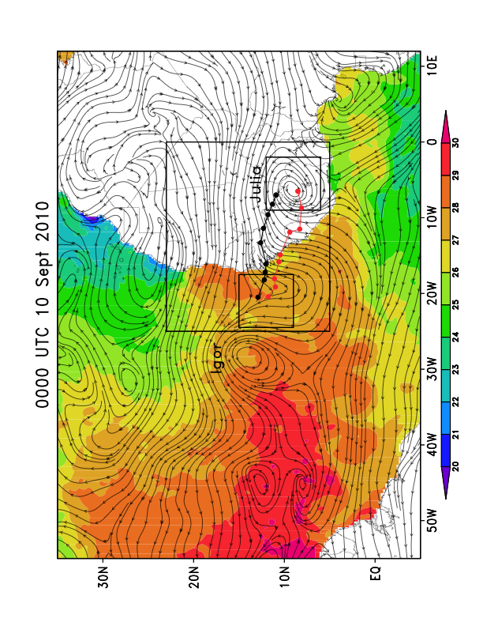
WRF Model Set-up
NOAA Optimal Interpolation SSTs (shaded, degrees C), 700-hPa Streamlines (resting frame) from ERA-Interim for the initialization time of the WRF simulation.
Notes:
NOAA Optimal Interpolation SST data was used since Igor passed over a similar track shortly before Julia. As seen in the SST data, cooling is found south of the Cape Verde Islands where Igor passed over. These cooler SSTs were not resolvable by the coarser ERA grid, but were by the .25 degree OI data.

Slide 7
WRF Validation
Average P_{MIN} error from observed was 1.67 hPa. Track errors had substantial more latitudinal error than longitudinal.
Notes:
The storm was slow to strengthen with most strengthening taking place after costal transition.

Slide 8
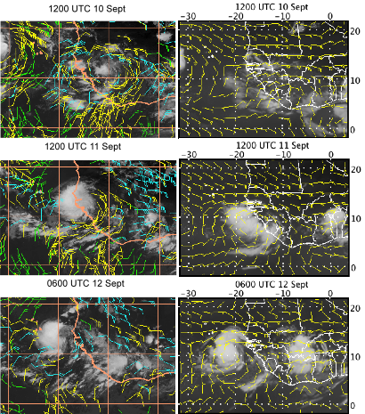
WRF Outgoing Longwave Radiation (OLR, shaded, white/gray low OLR) and 700-hPa wind barbs
METEOSAT-9 IR Imagery with satellite-derived winds
400-599 hPa (blue)
600-799 hPa (yellow)
800-950 hPa (green)
Julia
Notes:
Subjective analysis shows good agreement with the spatial distribution of clouds when compared to the METEOSAT-9 IR imagery. Comparing the wind fields from the 600-799 hPa layer (yellow barbs on LHS) with the 700 hPa WRF wind barbs, see a significantly more zonal component, associated with the AEJ to the north of the storm. This more zonal flow certainly could have suppressed the storm further south than the observed track.

Slide 9
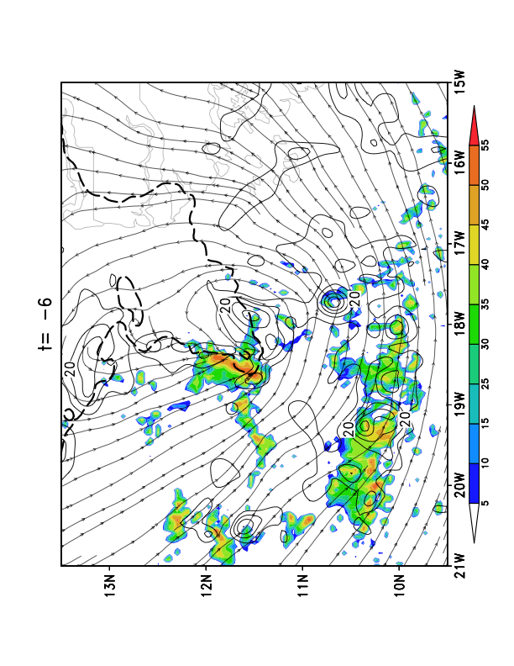
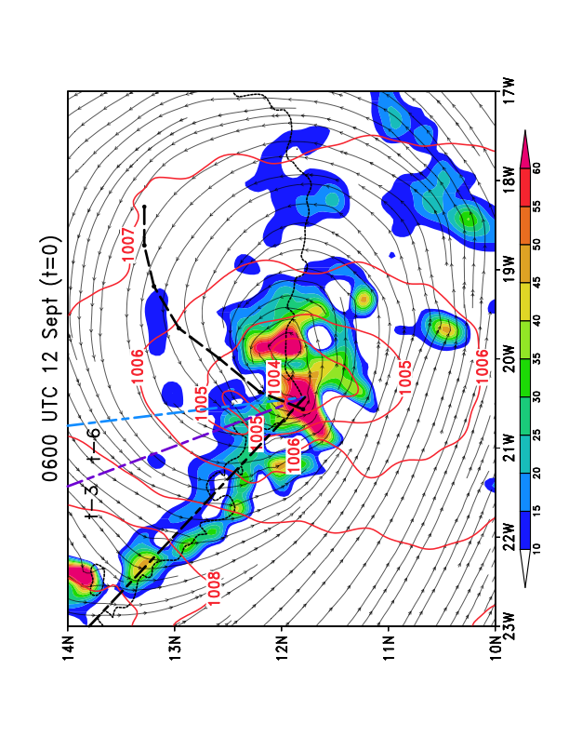
Transition from AEW to Julia
925-hPa co-moving streamlines, relative vorticity (shaded) and MSLP (red contours, every 1 hPa). Black line represents hourly-based back-trajectory of vorticity center that becomes co-located with the AEW circulation center. The AEW trough axis at 3 times is superimposed, with the black-dashed line being the current time trough axis. The critical latitude is shown with a dotted line.
925-hPa Radar reflectivity (shaded) relative vorticity (contours), co-moving streamlines and the critical latitude (dashed line) 6 hours prior to 0600 UTC 12 Sept
How did it strengthen over the 6-hour period?

Slide 10
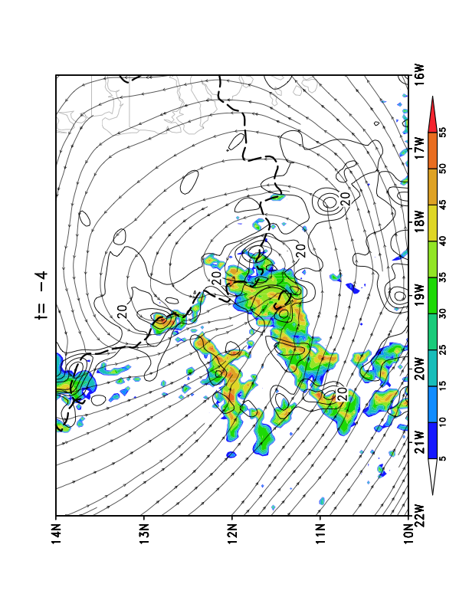
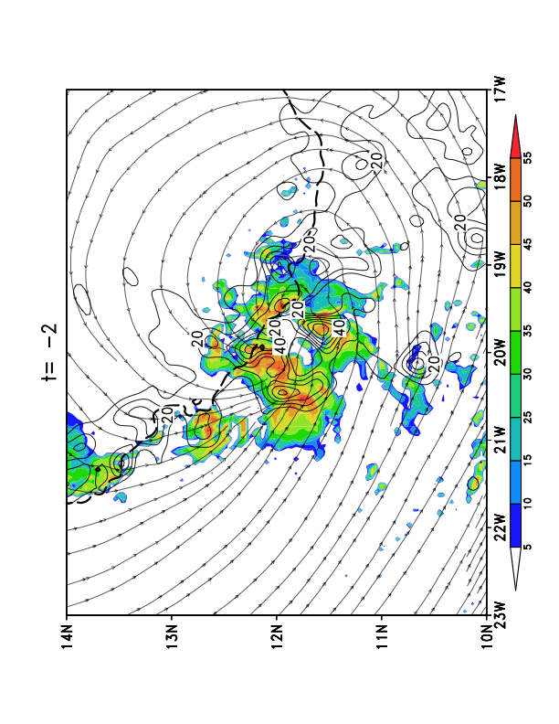
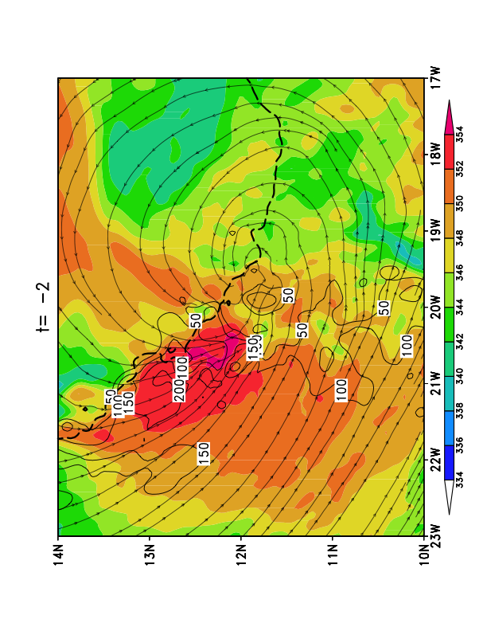
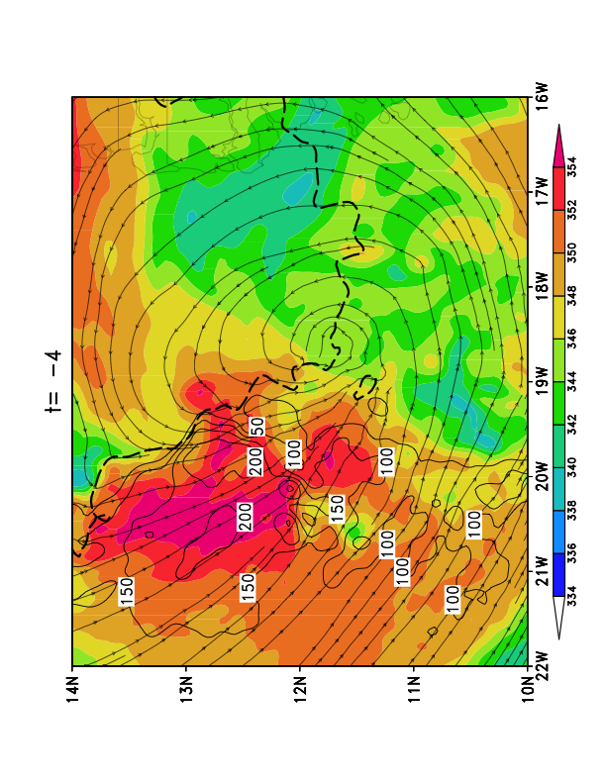
925-hPa Radar reflectivity (shaded), relative vorticity (contours), co-moving streamlines and critical latitude (dashed line)
925-hPa Theta-e (shaded), 0-3km Storm-relative helicity (contours), co-moving streamlines and critical latitude (dashed line)
Notes:
See high theta-e to the NW of the AEW center, where convection is invigorated or even re-initiated from remnant vorticity maxima. The CAPE in the center of the AEW is very small because of the typical thermodynamical structure of an AEW, with cooling below the mid-level vortex and warming aloft.

Slide 11
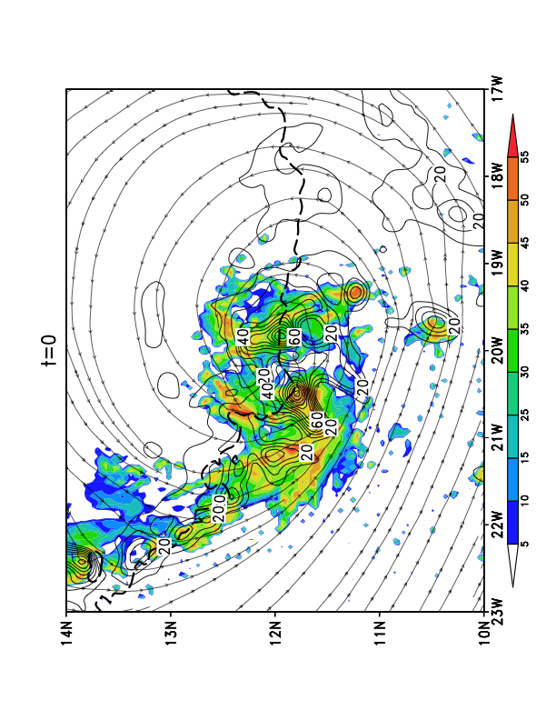
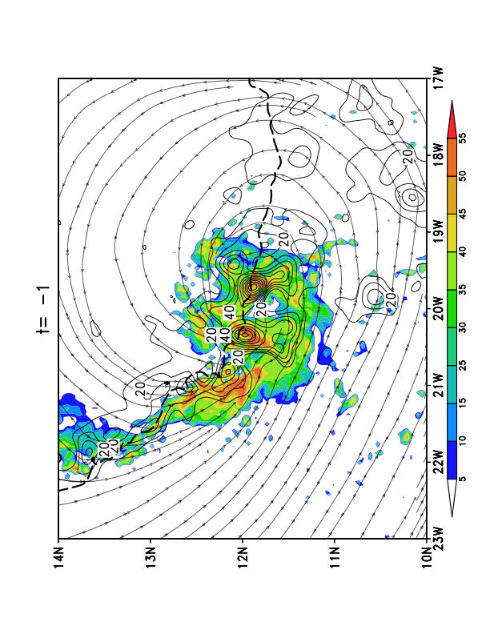
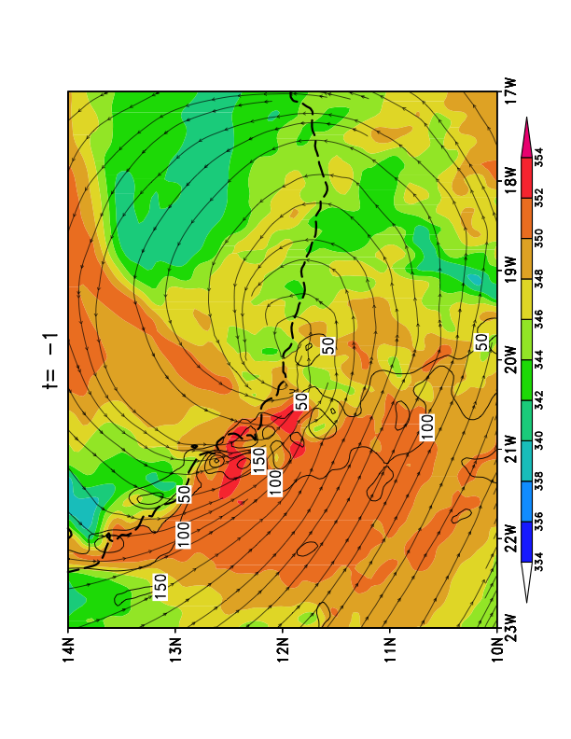
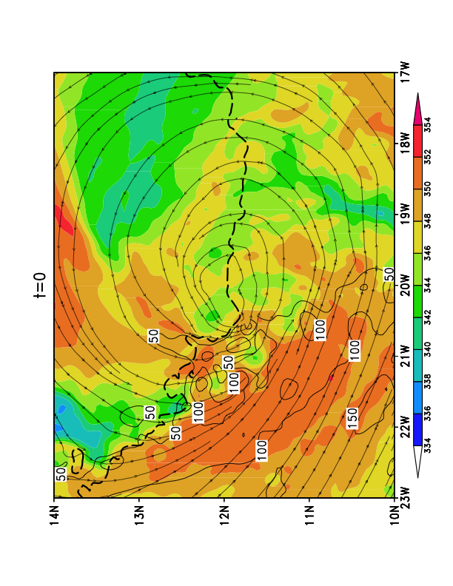
925-hPa Radar reflectivity (shaded), relative vorticity (contours), co-moving streamlines and critical latitude (dashed line)
925-hPa Theta-e (shaded), 0-3km Storm-relative helicity (contours), co-moving streamlines and critical latitude (dashed line)
Notes:
See high cape to the NW of the AEW center, where convection is invigorated or even re-initiated from remnant vorticity maxima. The CAPE in the center of the AEW is very small because of the typical thermodynamical structure of an AEW, with cooling below the mid-level vortex and warming aloft.

Slide 12
Concluding Remarks
The genesis of Julia occurred from an initially unstable, vertically tilted AEW with a PV maxima around 450-hPa;
While the AEW provides favorable forcing for convective development, merging of meso-β-scale vortices generated in rainbands accounts for the genesis of Julia;
High θ_{e}air to the north and west of the storm invigorates convection while ingestion of high sfc-3km SRH aids in cyclonic relative vorticity development at 925 hPa;
As hypothesized by Dunkerton, et al. 2009, the critical latitude provides a preferred region for amplification of meso-β development (their H1);
This low-level cyclonic vorticity development leads to genesis, both through convective enhancement and the critical latitude acting as an ‘attractor’ for meso-β cyclonic vortices

